Slide 1
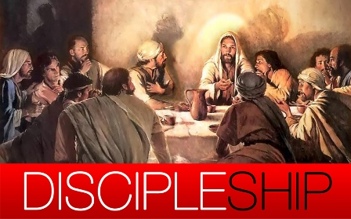
Equip Your
Serving Hands
40
days of

Slide 2
40 Days of Discipleship
Learn
Follow
Serve (事奉)
The word disciple literally means “ Learner”
Develop the habit, attitude, skills to learn spiritually
Imitate Jesus; Bear Fruit; Follow Him to love
Serve with Jesus – to establish the kingdom of God
Learn the heart, attitude, mind-set, and skills to serve God
Live a life worthy of the calling of God

Slide 3
The Goal of Serving
And Jesus came and spoke to them, saying, “All authority has been given to Me in heaven and on earth. Go therefore and make disciples of all the nations, baptizing them in the name of the Father and of the Son and of the Holy Spirit, teaching them to observe all things that I have commanded you; and lo, I am with you always, even to the end of the age.” Amen.

Slide 4
The Goal of Serving
Not to lead people to Heaven.
To make disciples.
Lead them to Jesus is the most important step but not the only step.
We are also partners in disciple making.

Slide 5
Make Disciples
To preach the Gospel.
To assist them in things they cannot do.
To teach them the commandments of Jesus.
To guide/insist them in practice.

Slide 6
Make Disciples
Prayers.
Holy Spirit.
Holy Bible.

Slide 7
2 Tim 3:16-17
All Scripture is given by inspiration of God, and is profitable for doctrine, for reproof, for correction, for instruction in righteousness, that the man of God may be complete, thoroughly equipped for every good work.

Slide 8
Fluency in The Bible
The central plan.
Relationship of each part.
Relationship to this world.
Practicing the Bible.

Slide 9
Practicing
Not perfect before you do it, do it until it is prefect.
Not for the excitement but for the skills.
Not for the result but towards the result.

Slide 10
Practicing The Bible
To God.
To each other.
To the world.

